Slide 1
Exploring network effects during bank failures in Argentina
Emiliano A. Carlevaro
University of Western Australia
34 PhD Conference Economics
University of Queensland
Research supported through an Australian Government RTP Scholarship and the University of Western Australia Dean's Excellence PhD Scholarship.
Notes:
Bank mutual relations comprise multiple areas: syndicated loans market (many banks lending the same borrower), overnight interbank market, derivative positions (or swaps), wholesale deposit market. We only consider loans reported in the credit registry.
Interbank market data relies on trading data. In some cases the identities of the parties is unknown

Slide 2
Hypothesis
Capital structure
Network
Empirical model
Probit
Spatial autoregressive
Estimation
Data
The Network
Balance sheet
Results
70% of failing banks were directly linked.
Notes:
Excluyo bancos publicos y sucursales de bancos extranjeros como en DABOS SOSA 2004 bajo la idea de que es menos probables a quebrar.
bankFailure/output/SAR/Annual99_pastAvgW/A99_pastAvgW_creW_b97q4_s03q4.html

Slide 3









Why do banks fail?
Capital structure
Diamond & Dybvig (1983)
Holmström & Tirole (1997)
Diamond & Rajan (2005)
Whalter (2016)
Diamond & Rajan (2001)
$$p_{i}^{∗}$$
$$p_{j}^{∗}$$
$$p_{k}^{∗}$$
Berger 1995, JMCB
Gonzales-Hermosillo (1999)
Dabos Sosa-Escudero (2004)
Arena (2005)
“Virtually all such studies find that low capital ratios raise the probability of bank failure.”
Berger & Roman (2020)
Notes:
El apalancamiento excesivo en relación al riesgo tomado en el active y/o el fondeo con deuda de corto plazo. En el caso argentino el descalce de moneda
Is the same?
Are more connected system more resilient? Depends
Diamond & Rajan: you don’t need a network to have contagious, amplyfing effects. All banks are connected through markets.
What it does not say: an arbitrary macro shocks does not generate contagious.

Slide 4
Why do banks fail?
Network effects
Allen & Gale 2000
Acemoglu, Carvalho, Ozdaglar Tahbaz-Salehi (2012)
Acemoglu, Ozdaglar Tahbaz-Salehi (2015)
$$p_{i}^{∗}$$
$$p_{j}^{∗}$$
$$p_{k}^{∗}$$
Virtually all such studies assume independent and thus isolated banks.
Estimation
Network data
Notes:
Is the same?
Are more connected system more resilient? Depends
Diamond & Rajan: you don’t need a network to have contagious, amplyfing effects. All banks are connected through markets.
What it does not say: an arbitrary macro shocks does not generate contagious.

Slide 5





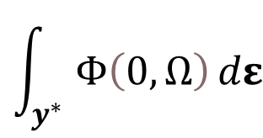













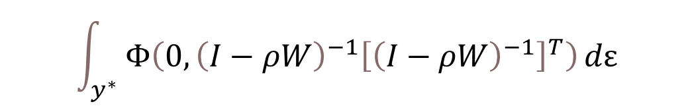








Estimation
$$y_{i,t}^{∗}=ρ\left(w_{j,t}y_{j,t}^{∗}+w_{h,t}y_{h,t}^{∗}\right)+x_{i,t}^{T}β+ε_{i,t}$$
$$ε_{i,t }∼𝒩\left(0,1\right)$$
Probit model
$$y_{i}^{∗}=x_{i}^{T} β + ε_{i}$$
$$ε_{i}∼𝒩\left(0,1\right)$$
$$y^{∗}=ρWy^{∗}+Xβ+ε$$
$$y_{i}=x_{i}^{T} β+u_{i}$$
i i d
$$y^{∗}=ρWy^{∗}+Xβ+ε$$
$$y_{t}^{∗}={\left(I−ρW\right)}^{−1} Xβ +{\left(I−ρW\right)}^{−1}ε$$
$$p_{i}$$
$$y_{i}=$$
$$1$$
with probability
$$Φ\left[x_{i,t}^{T} β \right]$$
$${1−p}_{i}$$
$$x_{i,t}^{T}β$$
$$0$$
with probability
$$ν$$
$$∼𝒩$$
Likelihood function
$$(0,$$
$$?)$$
$${\left(I−ρW\right)}^{−1}{\left[{\left(I−ρW\right)}^{−1}\right]}^{T}$$
$$\prod_{i=1}^{N}{}$$
$$Ω=E\left[νν^{T}\right]$$
$$ℒ_{𝓉}=f\left(y^{} | X;β\right)=$$
$${Φ\left[x^{T} β\right]}_{i}^{y_{i}}{\left(1−{Φ\left[x^{T} β\right]}_{i}\right)}^{1−y_{i}}$$
Newton-Raphson algorithm
$$Ω={\left(I−ρW\right)}^{−1}{\left[{\left(I−ρW\right)}^{−1}\right]}^{T}$$
$$ℒ_{𝒾,𝓉}=f\left(y^{∗} | X_{t−1},y;β, ρ \right)=$$
$$Φ\left(0,Ω\right)$$
$$\int_{y^{∗}}{Φ\left(0,Ω\right)}dε$$
$$\int_{y^{∗}}{Φ\left(0,{\left(I−ρW\right)}^{−1}{\left[{\left(I−ρW\right)}^{−1}\right]}^{T}\right)}dε$$
Efficient importance sampling
Simulated Maximum Likelihood
EIS-SML
Notes:
You want the estimate the asterisk model where the shocks are Normal(0,1). These shocks can be think of the shocks bank faces like ratio of late-paying borowwers.
You can’t cause there are unobservables.
You estimate with the observables.
Recognized that with observables the dependant is binomial. What is the value of p?
Well, you let p to depend on X, that is, you parametized p. The link function is the Normal Density. Why? Cause shocks in the structural are Normal

Slide 6






































Estimation
Probit case
Spatial autoregressive process SAR(1)
$$y_{i,t}^{∗}=x_{i,t}^{T} β + u_{i,t}^{∗}$$
$$u_{i,t }^{∗}∼𝒩\left(0,1\right)$$
$$y_{i}=$$
$$ρ\left(w_{j}y_{j}+w_{k}y_{k}\right)+$$
$$x_{i}^{T}β+ε_{i}$$
$$ε_{i }∼𝒩\left(0,1\right)$$
$$y_{i,t}=x_{i,t}^{T} β+u_{t}$$
i i d
$$y=ρW y+Xβ+ε$$
$$ε∼𝓝\left(0,I\right)$$
Feedback effects
$$y={\left(I−ρW\right)}^{−1} Xβ +{\left(I−ρW\right)}^{−1}ε$$
$$p_{i,t}$$
$$y_{i,t}∼ℬinomial\left(N=1,p_{i,t}\right)$$
$$y_{i,t}=$$
$$1$$
with probability
$$p_{i,t}^{y_{i,t}}{\left(1−p_{i,t}\right)}^{1−y_{i,t}}$$
$$Φ\left[x_{i,t}^{T} β \right]$$
$$u$$
$$∼𝒩$$
$$?)$$
$$Ω=E\left[uu^{T}\right]$$
$p_{i,t}$ $=$
$$x_{i,t}^{T}β$$
$$(0,$$
$${\left(I−ρW\right)}^{−1}{\left[{\left(I−ρW\right)}^{−1}\right]}^{T})$$
$${1−p}_{i,t}$$
$$¿?$$
$$0$$
with probability
$$P\left(Y_{i,t}=1\right)=$$
$$Ω=$$
$${\left(I−ρW\right)}^{−1}{\left[{\left(I−ρW\right)}^{−1}\right]}^{T}$$
$${Φ\left[x^{T} β\right]}_{i,t}^{y_{i,t}}{\left(1−{Φ\left[x^{T} β\right]}_{i,t}\right)}^{1−y_{i,t}}$$
Likelihood function
i i d
Likelihood function
$$\ln{L\left(β,σ^{2},ρ\right)}=−\left(n/2\right)\ln\left(πσ^{2}\right)+ln\{\left|I_{n}−ρW\right|\} −\frac{u^{′}u}{2σ^{2}}$$
$$ℒ_{𝒾,𝓉}=f\left(y_{i,t}^{} | x_{t};β\right)=$$
$$ℒ=f\left(y | X;β, ρ \right)=$$
$$\prod_{i=1}^{N}{}$$
$$ℒ_{𝓉}=f\left(y_{t}^{} | X_{t};β\right)=$$
$${Φ\left[x^{T} β\right]}_{i,t}^{y_{i,t}}{\left(1−{Φ\left[x^{T} β\right]}_{i,t}\right)}^{1−y_{i,t}}$$
$$\int_{y^{∗}}{Φ\left(0,{\left(I−ρW\right)}^{−1}{\left[{\left(I−ρW\right)}^{−1}\right]}^{T}\right)}dε$$
Newton-Raphson algorithm
Notes:
El modelo SAR permite feedback effects.
The inversion of the matrix I-pW, it’s a NxN matrix! That takes N^3 iterations. Sparse matrix algorithms Pace, R. Kelley, and James P. LeSage. "Fast Simulated Maximum Likelihood Estimation of the Spatial Probit Model Capable of Handling Large Samples, chapter 1." (2011): 3-34.
The more fundamental problem of the likelihood. The value for a particular observation depends on the others!!

Slide 7


Building the network
$$y=ρW y+Xβ+ε$$
Interbank loans
(Overnight) Interbank market
 | Bank A | Bank B | Bank C
Bank A | 0 | ? | ?
Bank B | ? | 0 | ?
Bank C | ? | ? | 0
TOTAL
100
120
15
Forte (2020)
$$W=$$
Balance sheet
Veld Lelyveld (2014)
TOTAL | 60 | 25 | 150 | 0
Credit registry
Central Bank Central de Deudores
Notes:
Federico Forte para mercado interbancario argentino (el mercado call).
Veld lelyveld para Países Bajos, otros para Brasil.
Banco mutual relations comprise multiple areas: syndicated loans market (many banks lending the same borrower), overnight interbank market, derivative positions (or swaps), wholesale deposit market. We only consider loans reported in the credit registry.
Interbank market data relies on trading data. In some cases the identities of the parties is unknown

Slide 8
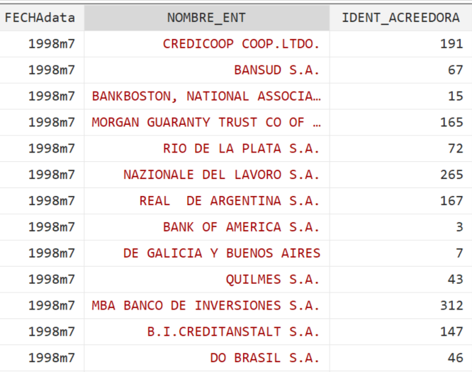
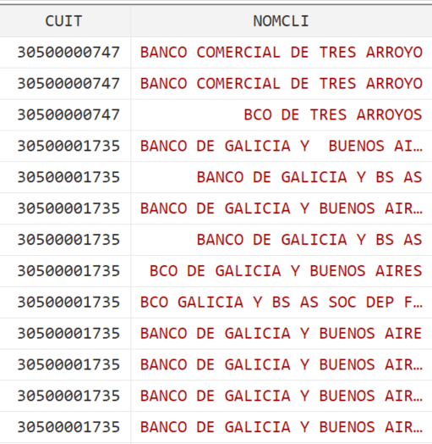
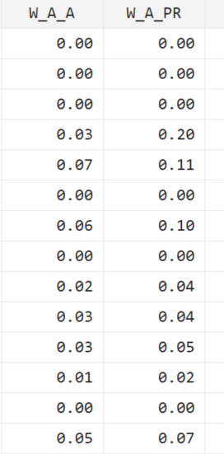
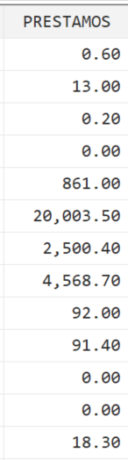
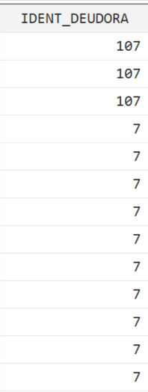

Building the network
$$y=ρW y+Xβ+ε$$
Credit registry
Central Bank Central de Deudores
Links weighted from lender bank perspective
Loans ARS$
Lender bank ID
(Overnight) interbank market
Debtor bank TFN
Debtor bank TFN
Interbank loans
Balance sheet data
 | Banco A | Banco B | Banco C | TOTAL
Banco A | 0 | ? | ? | 100
Banco B | ? | 0 | ? | 120
Banco C | ? | ? | 0 | 15
TOTAL | 60 | 25 | 150 | 0
 | Banco A | Banco B | Banco C | TOTAL
Banco A | 0 | ? | ? | 100
Banco B | ? | 0 | ? | 120
Banco C | ? | ? | 0 | 15
TOTAL | 60 | 25 | 150 | 0
Notes:
Cada banco debe actualizar la informacion al menos una vez por año, mas frecuenemtenete para deudas grandes. No hay incentive a mentir ya que no puede haber una diferencia mayor a 1 en el puntaje asignado a un deudora por diferentes bancos. Ademas un banco que considera todos sus deudores con un puntaje de 1 genera sospechas en el regulador.
Banco mutual relations comprise multiple areas: syndicated loans market (many banks lending the same borrower), overnight interbank market, derivative positions (or swaps), wholesale deposit market. We only consider loans reported in the credit registry.
Interbank market data relies on trading data. In some cases the identities of the parties is unknown

Slide 9

Building the network
$$y=ρW y+Xβ+ε$$
Credit registry
Central Bank Central de Deudores
Links weighted from lender bank perspective
Loans ARS$
Lender bank ID
(Overnight) interbank market
Debtor bank TFN
Debtor bank TFN
Interbank loans
Balance sheet data
 | Banco A | Banco B | Banco C | TOTAL
Banco A | 0 | ? | ? | 100
Banco B | ? | 0 | ? | 120
Banco C | ? | ? | 0 | 15
TOTAL | 60 | 25 | 150 | 0
 | Banco A | Banco B | Banco C | TOTAL
Banco A | 0 | ? | ? | 100
Banco B | ? | 0 | ? | 120
Banco C | ? | ? | 0 | 15
TOTAL | 60 | 25 | 150 | 0
Notes:
Cada banco debe actualizar la informacion al menos una vez por año, mas frecuenemtenete para deudas grandes. No hay incentive a mentir ya que no puede haber una diferencia mayor a 1 en el puntaje asignado a un deudora por diferentes bancos. Ademas un banco que considera todos sus deudores con un puntaje de 1 genera sospechas en el regulador.
Banco mutual relations comprise multiple areas: syndicated loans market (many banks lending the same borrower), overnight interbank market, derivative positions (or swaps), wholesale deposit market. We only consider loans reported in the credit registry.
Interbank market data relies on trading data. In some cases the identities of the parties is unknown

Slide 10
The Network
# Links | # lender banks | # borrower banks | Average loan size (% lender total loans)
642 | 75 | 77 | 1.52
Notes:
Excluyo bancos publicos y sucursales de bancos extranjeros como en DABOS SOSA 2004 bajo la idea de que es menos probables a quebrar.
bankFailure/output/SAR/Annual99_pastAvgW/A99_pastAvgW_creW_b97q4_s03q4.html

Slide 11
The Network
70% of failing banks were directly linked.
Notes:
Excluyo bancos publicos y sucursales de bancos extranjeros como en DABOS SOSA 2004 bajo la idea de que es menos probables a quebrar.
bankFailure/output/SAR/Annual99_pastAvgW/A99_pastAvgW_creW_b97q4_s03q4.html

Slide 12
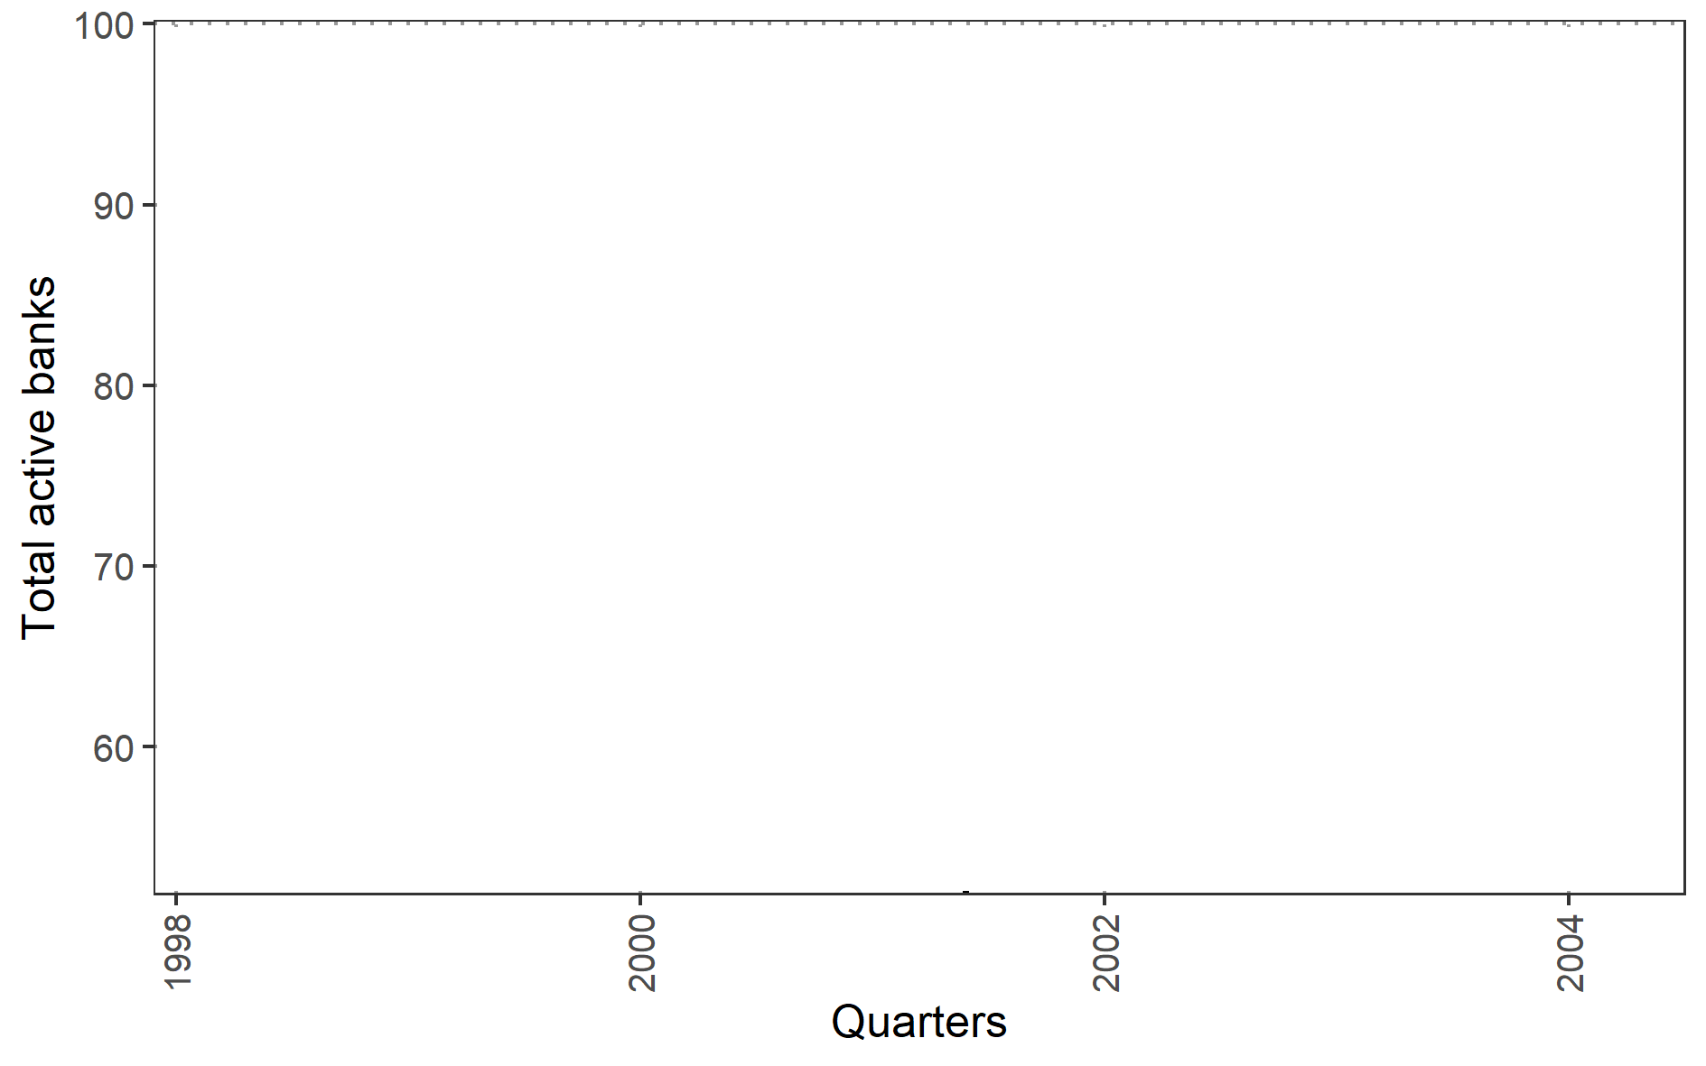
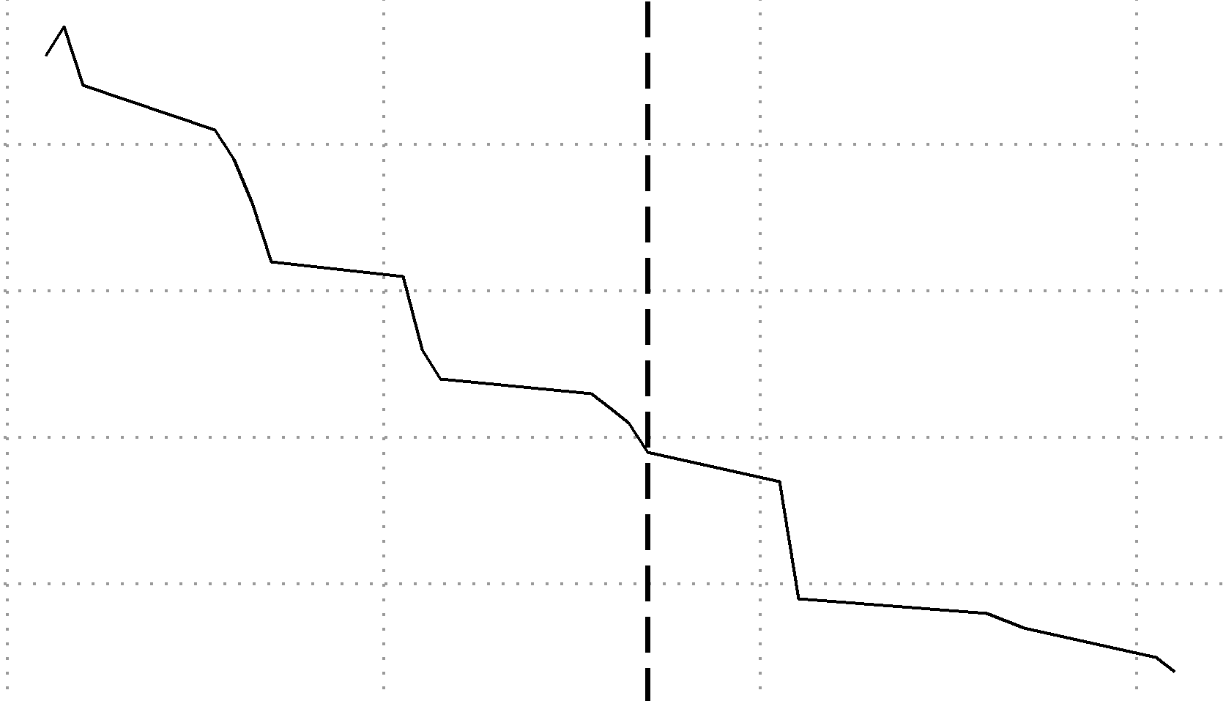

Descripción de la muestra
$$y=ρW y+Xβ+ε$$
Falla
Cualquier extinción declarada por el BCRA
Variable | Mean | SD
Assets (ARS$/USD billions) | 1,047.00 | 2,168.00
Capital (%) | 16.28 | 12
Non-performing loans (%) | 9.43 | 10
ROA (%) | 0.51 | 3
Deposits interest rate (%) | 5.36 | 3
Loans interest rate (%) | 23.64 | 10
Lending to public sector (% loans) | 3.85 | 9
USD loans (% loans) | 55.55 | 23
Loans-to-Assets (%) | 50.35 | 17
Brazil devaluation
Federal govt. collapsed
Fed tightening
New federal govt.
Currency board abandoned
New federal govt.
 | 1998
N | 105.00
SampleStart | 1998
Failure until | 2001
SurvivalRate | 0.66
5 Presidents
2001q4
Notes:
Include M&A
s98.Priv.01.onT
: 1998 annual data results/probit/failureUntil2001q4/probits-AnnualData.html
Brazil, Russian default, Fed tightening

Slide 13
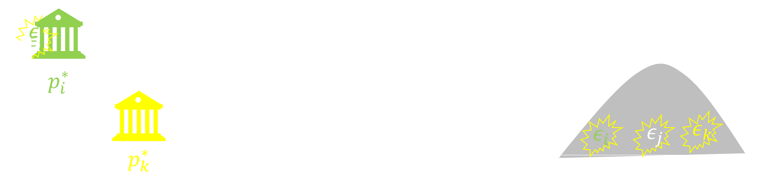

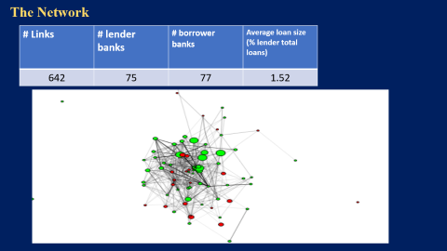
Hypothesis
Capital structure
Network
Empirical model
Probit
Spatial autoregressive
Estimation
Data
The Network
Balance sheet
Results
1/3 of shocks are transmitted
This changes the effect of capital
70% of failing banks were directly linked.
Notes:
Excluyo bancos publicos y sucursales de bancos extranjeros como en DABOS SOSA 2004 bajo la idea de que es menos probables a quebrar.
bankFailure/output/SAR/Annual99_pastAvgW/A99_pastAvgW_creW_b97q4_s03q4.html

Slide 14







Sample description
$$y=ρW y+Xβ+ε$$
Entities
Active at 1997q4
Local private
Complete observations
N | 78
Survival rate | 0.70
Time
$1$, if survives
$$y$$
$$=$$
$$\overline{W}$$
$$\overline{X}$$
$0$, if fails
1997q4
1998q4
1998q4
1999q1
1999q4
2000q1
2003q4
Notes:
Excluyo bancos publicos y sucursales de bancos extranjeros como en DABOS SOSA 2004 bajo la idea de que es menos probables a quebrar.
bankFailure/output/SAR/Annual99_pastAvgW/A99_pastAvgW_creW_b97q4_s03q4.html

Slide 15

Sample description
$$y=ρW y+Xβ+ε$$
Predictor | Mean | Coef. of variation
Size
Assets in ARS $ (mill) | 1,300 | 2.06
Credit risk
Non-performing assets | 13.3 | 0.78
Lending rate | 23.9 | 0.43
Lending to Public Sector | 4.72 | 1.82
Lending in USD | 54.6 | 0.44
Loans-to-Assets | 49.8 | 0.32
Funding
Capital ratio | 18.4 | 0.73
ROA | -0.33 | 10.7
Deposit rate | 5.49 | 0.47
Annual predictors: within average for 1999
Falla ocurre entre 2000q1 y 2003q4
Notes:
s98.Priv.01.onT
: 1998 annual data results/probit/failureUntil2001q4/probits-AnnualData.html

Slide 16



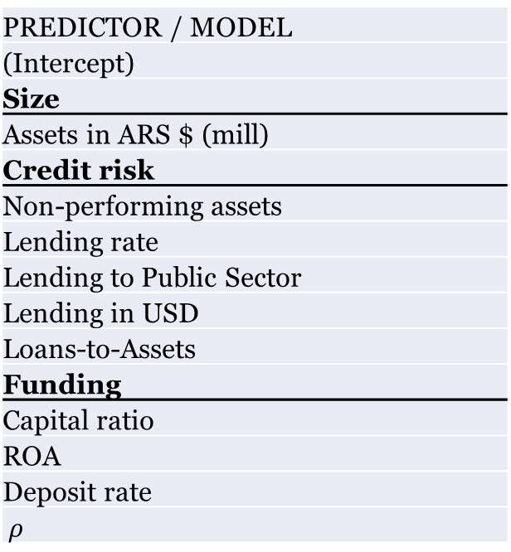
Results
$$y_{i}^{∗}=x_{i}^{T} β + ε_{i}$$
$$y=ρW y+Xβ+ε$$
Predicting variable:= $1(survival)$
Predictors at 1998 (annual average)
Failure horizon is 2001q4
PREDICTOR / MODEL
(Intercept)
Size
Assets in ARS $ (mill)
Credit risk
Non-performing assets
Lending rate
Lending to Public Sector
Lending in USD
Loans-to-Assets
Funding
Capital ratio
ROA
Deposit rate
$$ρ$$
OLS (linear) | OLSstars
1.343 | ***
0.000 | *
-0.013 | **
0.004
-0.005
-0.006 | ***
-0.005
0.003
0.008
-0.009
Probit | probitStars
2.757 | ***
0.000
-0.038 | **
0.007
-0.014
-0.022 | ***
-0.014
0.014
0.042
-0.036
Spatial autoregressive | SARstars
1.742 | ***
0.000 | ***
-0.018 | ***
0.001
-0.005
-0.007 | ***
-0.006 | ***
0.004
0.001
-0.006
-0.314
78
N
F-test p-value
Wald test spatial dependance
Likelihood ratio test spatial dependance
78
0.052
78
78
0.008
0.019
$$E\hat{\left[\frac{∂y_{i}^{∗}}{∂x_{cap,i}}\right]}=0.88±0.33$$

Slide 17










The contribution of capital structure to survival
Average marginal effect
$$y_{i}=Pr\left[y_{i}=1 | x_{i, k}\right]$$
OLS model
Probit model
SAR model
$$y_{i}^{∗}=x_{i}^{T} β + ε_{i}$$
$$y=ρW y+Xβ+ε$$
$$\hat{ρ}=−0.31$$
$$E\left[\frac{∂ y_{i}}{∂x_{i,k}}\right]=β_{k}$$
$$E\left[\frac{∂ y_{i}}{∂x_{i,k}}\right]=ϕ\left(x_{i}^{T}β\right) β_{k}$$
$$E\left[\frac{∂y_{i}}{∂x_{i,k}}\right]=\frac{β_{k}}{(1−ρ)}$$
$$=0.0030$$
$$=0.0037$$
$$=0.0032$$
Notes:
El efecto 0.0037 es poco mas de la mitad del efecto de prestamos en USD. Es decir, aumentar 2% el ratio de capital aumenta la probabilidad de supervivencia en lo mismo que aumentar en 1% los prestamos en USD.

Slide 18





Efectos marginales promedios
$$y_{i}=Pr\left[y_{i}=1 | x_{i}\right]$$
Modelo SAR
Predictor | Efecto marginal x100
 | Directo | Indirecto | Total
$$y=ρW y+Xβ+ε$$
$$\hat{ρ}=−0.31$$
Ratio de capital
0.43 | -0.10 | 0.32
$$E\left[\frac{∂y_{i}}{∂x_{i,k}}\right]={\left(1−ρ\right)}^{−1} β_{k}$$
$$=0.0032$$

Slide 19
Conclusiones
$$y_{i}=Pr\left[y_{i}=1 | x_{i}\right]$$
Modelo SAR
Predictor | Efecto marginal x100
 | Directo | Indirecto | Total
$$y=ρW y+Xβ+ε$$
$$\hat{ρ}=−0.31$$
Ratio de capital
0.43 | -0.10 | 0.32
$$E\left[\frac{∂y_{i}}{∂x_{i,k}}\right]={\left(1−ρ\right)}^{−1} β_{k}$$
$$=0.0032$$

Slide 20
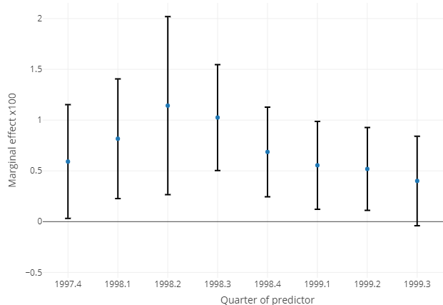






Results
 | Survival probability
 | Coefficients x 100
Capital ratio | 2.36 | **
Non-perfoming loans ratio | -3.10
Deposits interest rate (%) | 8.86 | *
Loans interest rate (%) | 1.33
ROA (%) | 8.82
Lending to public sector ratio | 9.48 | **
USD loans percentage (%) | 0.02
Loans-to-Assets ratio | 0.20
N | 105
AIC | 121
logLik (df=10) | -50.55
Probit case
Predictors at quarterly frequency since 1997q4 to 1999q3
Failure horizon is 2001q4
Predictors at 1998 (annual average)
Failure horizon is 2001q4
$$y_{i,t}^{∗}=x_{i,t}^{T} β + u_{i,t}^{∗}$$
$$u_{i,t }^{∗}∼𝒩\left(0,1\right)$$
$$\sum_{i=1}^{N}{}$$
$$E\hat{\left[\frac{∂y_{i}^{∗}}{∂x_{k,i}}\right]}=$$
$$φ\left( x_{i}^{T} \hat{β}\right)$$
$$\hat{β_{k}}$$
Marginal effect capital (at 90%)
$$E\hat{\left[\frac{∂y_{i}^{∗}}{∂x_{cap,i}}\right]}=0.88±0.33$$
Notes:
Bank mutual relations comprise multiple areas: syndicated loans market (many banks lending the same borrower), overnight interbank market, derivative positions (or swaps), wholesale deposit market. We only consider loans reported in the credit registry.
Interbank market data relies on trading data. In some cases the identities of the parties is unknown

